Slide 1
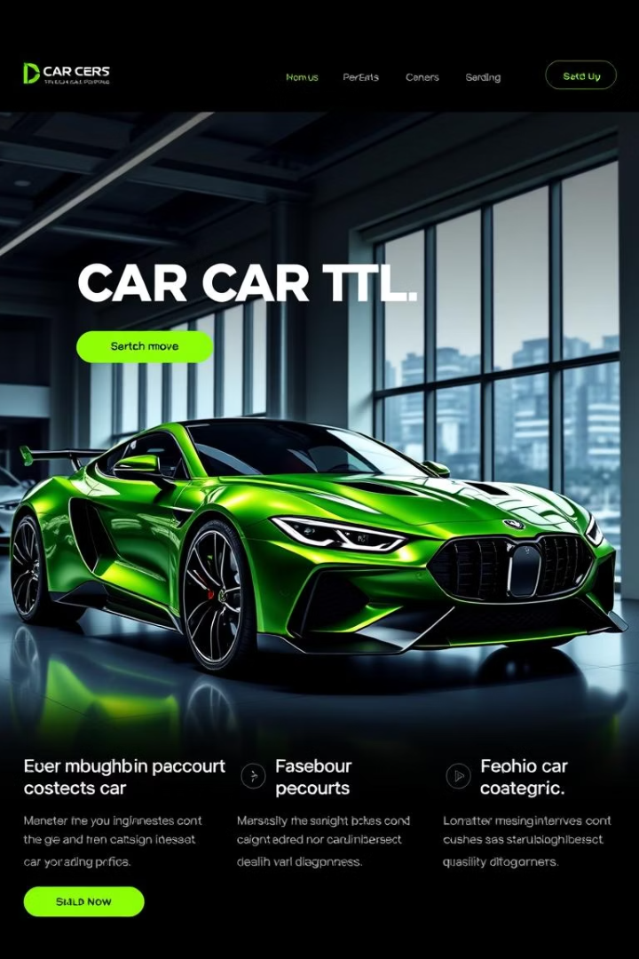



AutoRevzz: A Modern Car Listing Website
Presented by Yash, Krishna, and Ritik.
autorevzz

Slide 2
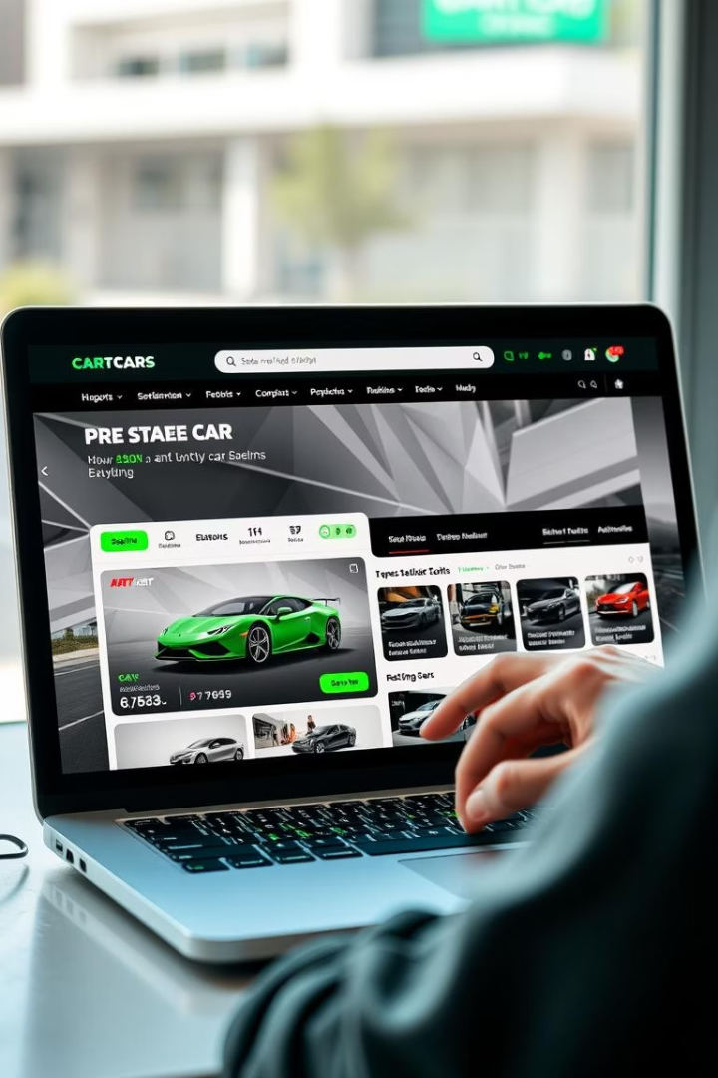

Introduction
AutoRevzz offers a sleek, user-friendly interface for browsing used cars.
Users can view detailed specs and multiple visual perspectives of each car.
Built with HTML, CSS, and JavaScript for a clean, intuitive design.
autorevzz

Slide 3
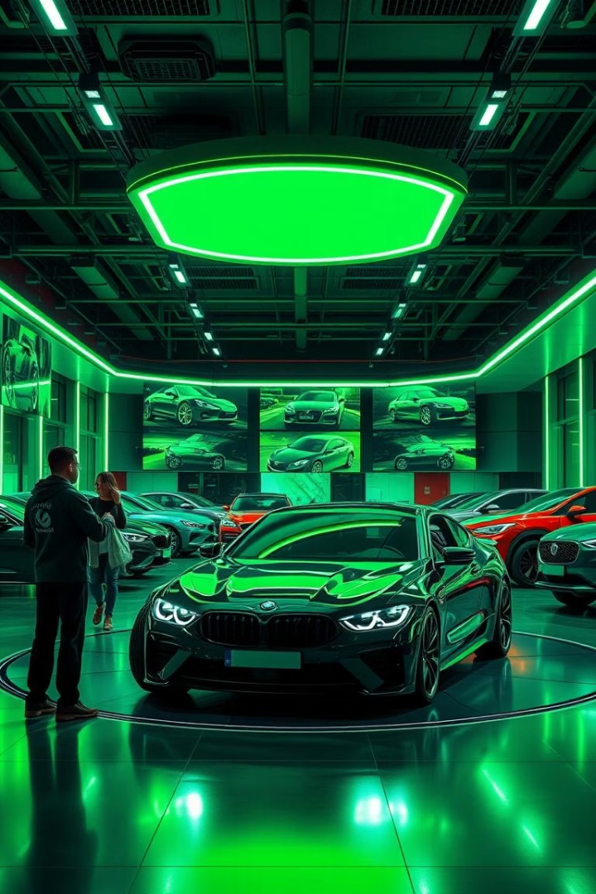

Project Objectives
User-Friendly Platform
Visual Richness
Provide high-quality images to simulate showroom experience.
Seamless exploration of used cars online.
Simple Navigation
Easy-to-use design that mimics real-world browsing.
autorevzz

Slide 4






Key Features
Individual car detail pages.
Multiple views: front, interior, engine, boot, and tyres.
Price and EMI information presented clearly.
Inspection reports and assurance badges for credibility.
Book Now button and Ownership Cost Estimator.

Slide 5

Technologies Used
HTML
CSS
JavaScript
Defines the content structure of the website effectively.
Stylizes the layout for a clean, responsive, and modern look.
Enables interactive features like image switching and dynamic content.
autorevzz

Slide 6


Team Members and Roles
1
Yash
Responsible for HTML Structure and Layout design.
2
Krishna
Handled CSS design and styling for the site.
3
Ritik
Implemented JavaScript interactivity and functionality.
autorevzz

Slide 7
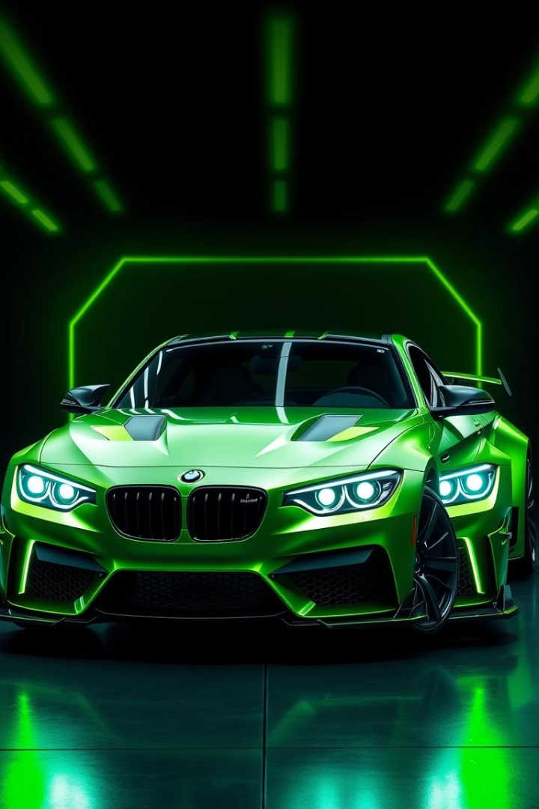

Conclusion
Showcased Front-End Skills
Demonstrated proficiency in building a clean, functional platform.
Engaging Experience
Designed for ease of use and visual appeal.
Thank You
autorevzz

